Slide 1

Stewardship Lessons for Timothy
From 1 Timothy 6

Slide 2
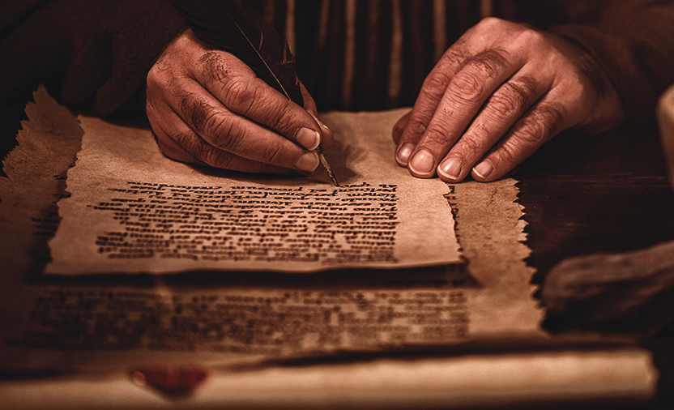
stewardship lessons for timothy
Paul was writing to alert Timothy to …
“constant friction among people who are depraved in mind and deprived of the truth, imagining that godliness is a means of gain.” (v5)

Slide 3
stewardship lessons for timothy
01
02
03
01
WANT TO BE RICH?
NOT RICH?
ARE RICH?
three categories of people
Notes:
© Copyright PresentationGo.com – The free PowerPoint library

Slide 4
01 for those who are not rich
Paul’s lessons
Key Issues
6. But godliness with contentment is great gain,
7. for we brought nothing into the world, and we cannot take anything out of the world.
8. But if we have food and clothing, with these we will be content
Godliness
Contentment
Ownership
Enough

Slide 5
02 for those who want to be rich
Paul’s lessons
Key Issues
9. But those who desire to be rich fall into temptation, into a snare, into many senseless and harmful desires that plunge people into ruin and destruction.
10. For the love of money is a root of all kinds of evils. It is through this craving that some have wandered away from the faith and pierced themselves with many pangs.
Focus on riches
Wants, needs
Debt trap
Spiritual and emotional problems
Serving mammon

Slide 6
03 for those who are rich.
Paul’s lessons
Key Issues
17. As for the rich in this present age, charge them not to be haughty, nor to set their hopes on the uncertainty of riches, but on God, who richly provides us with everything to enjoy.
18. They are to do good, to be rich in good works, to be generous and ready to share,
19. thus storing up treasure for themselves as a good foundation for the future, so that they may take hold of that which is truly life.
Pride
Trusting God or mammon
Good works
Generous and sharing
Laying up for yourselves ‘treasures in heaven

