Slide 1

Two Treasures, Two Eyes & Two Masters
From Mattthew 6:19-24

Slide 2
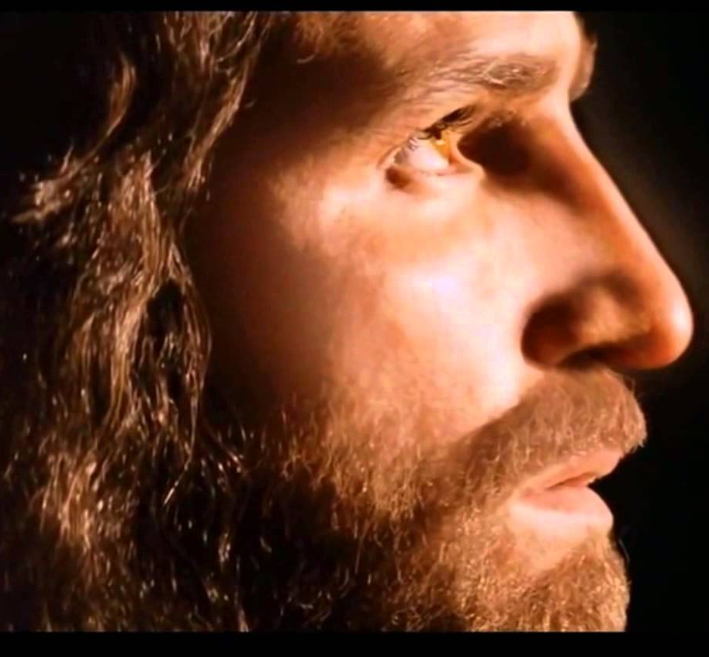
Two Treasures
“Do not lay up for yourselves treasures on earth, where moth and rust destroy and where thieves break in and steal, but lay up for yourselves treasures in heaven, where neither moth nor rust destroys and where thieves do not break in and steal. For where your treasure is, there your heart will be also.”

Slide 3
Two Treasures
EARTH
HEAVEN
Moth & Rust destroy
  Lost value
Thieves steal
  Lost enjoyment
A poor investment
Lasting
  Value added
Secure
  Usable (‘for yourselves’)
A great investment

Slide 4
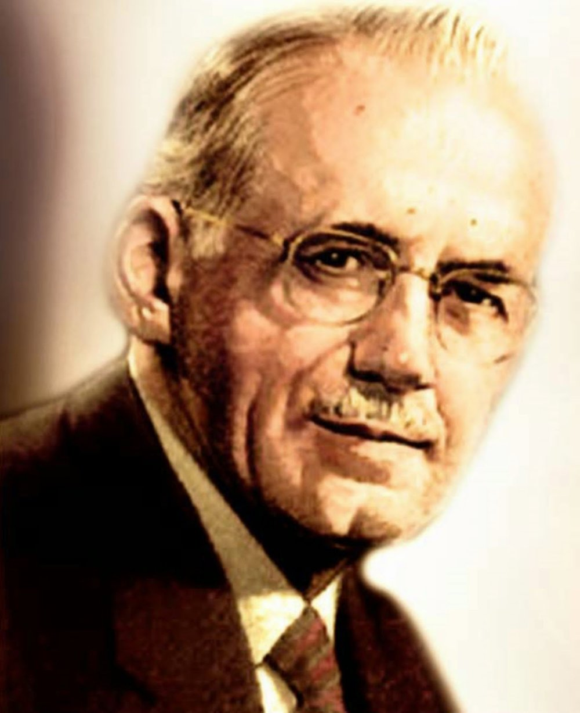
Treasures?
“What do we value most?
What would we most hate to lose? What do our thoughts turn to most frequently when we are free to think of what we will?
And finally, what affords us the greatest pleasure?”
A.W. Tozer

Slide 5
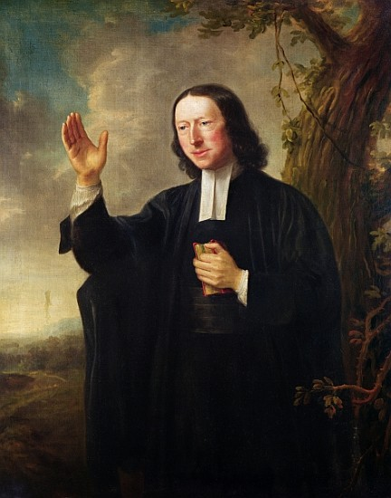
Treasures?
“I value all things only by the price they shall gain in eternity.”
John Wesley

Slide 6
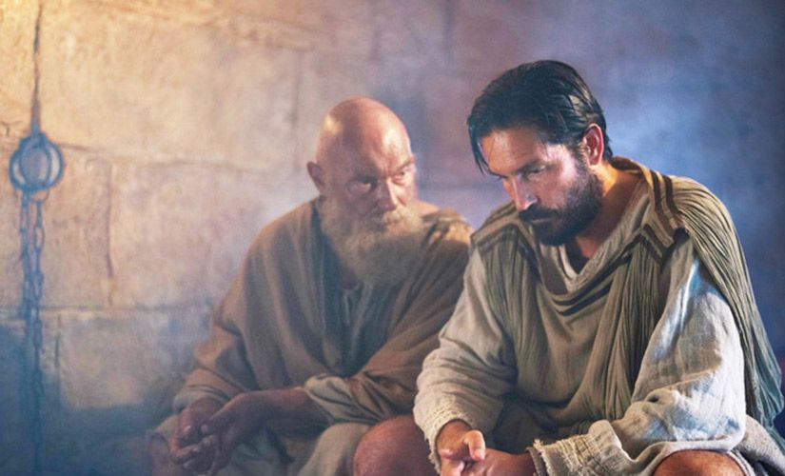
Investing in Treasures in Heaven
“As for the rich in this present age, charge them not to be haughty, nor to set their hopes on the uncertainty of riches, but on God, who richly provides us with everything to enjoy. They are to do good, to be rich in good works, to be generous and ready to share, thus storing up treasure for themselves as a good foundation for the future, so that they may take hold of that which is truly life.” (1 Timothy 6:17-19)
Paul to Timothy

Slide 7
Two Eyes
“The eye is the lamp of the body. So, if your eye is healthy, your whole body will be full of light, but if your eye is bad, your whole body will be full of darkness. If then the light in you is darkness, how great is the darkness!”

Slide 8


Two Eyes
Focus on the light
Out of focus - Darkness
Whoever is generous to the poor lends to the LORD, and he will repay him for his deed. (Pr. 19:17)
“the god of this world has blinded the minds of the unbelievers, to keep them from seeing the glory of Christ …” (1 Cor. 15:32)

Slide 9
Two Eyes
”Live for the Line, not the Dot!
“For this light momentary affliction is preparing for us an eternal weight of glory beyond all comparison, as we look not to the things that are seen but to the things that are unseen. For the things that are seen are transient, but the things that are unseen are eternal.” (2 Cor. 4:17,18)

Slide 10
Two Masters
“No one can serve two masters, for either he will hate the one and love the other, or he will be devoted to the one and despise the other. You cannot serve God and money.”

Slide 11




Two Masters
God <-> mammon
LOVE
HATE
DEVOTION
DESPISE

Slide 12
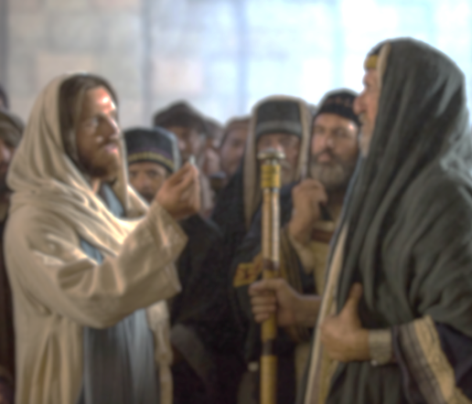
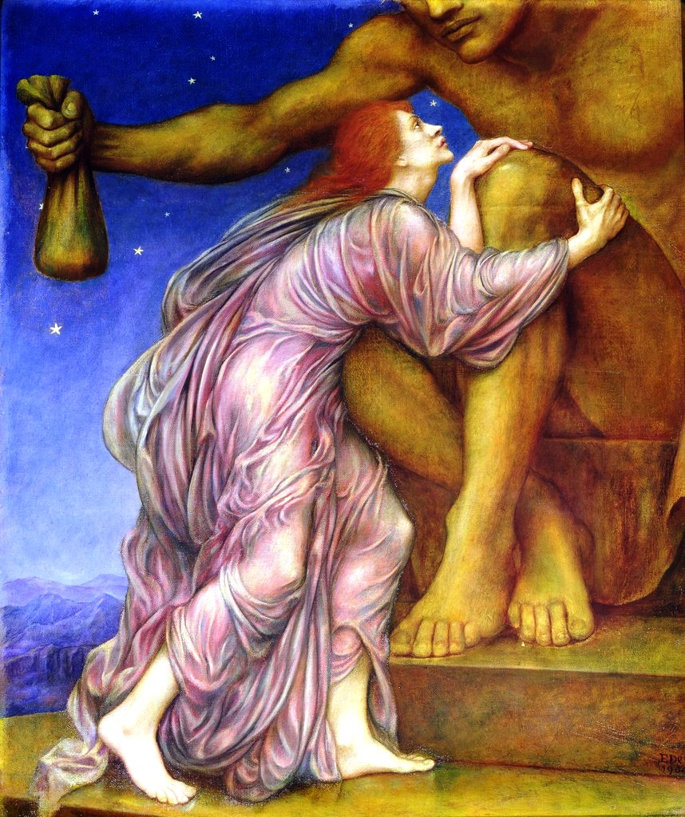
Two Masters
God <-> mammon
SERVE GOD
SERVE MAMMON
Notes:
‘mammon painting by Evelyn de Morgan 1900
In the painting, the woman has decided to turn her back on God and serve Mammon – she clutches desperately at the knee of the statue, yearning up into his face, which stares down at her remorselessly. The statue holds out a bag of gold, but the woman ignores the money. She has moved from the love of gold, to the love of Mammon himself and so has cut herself off from the love of God and has doomed herself.

Slide 13
Two Masters
“And I tell you, make friends for yourselves by means of unrighteous wealth (mammon), so that when it fails they may receive you into the eternal dwellings. (Luke 16:13)

Slide 14
Therefore ….
Do not be anxious
Your Father will provide
Seek first the Kingdom of God & his righteousness
‘All these things’ will be given to you.
Matthew 6:25-33

